Slide 1


Navami S (22MBS0003)
Vrinda S Nair (22MBS0024)
Nedunuri Sai Srividya (22MBS0032)
M.Sc. (Business Statistics)
Dept. of Mathematics
School of Advanced Sciences
STATISTICAL MODELLING OF DENGUE CASES IN INDIA : A DATA SCIENCE PERSPECTIVE
Under the guidance of
Dr.Jitendra Kumar
(Associate Professor)
Dept. of Mathematics
School of Advanced Sciences
SET ID- 222492

Slide 2

Content
01
Relevance
02
Work plan
03
Literature Review
04
Objectives
05
Methodology
06
Analysis and Results
07
Conclusion
08
References

Slide 3

RELEVANCE
Dengue is a vector-borne illness transmitted to people through the bite of an infected Aedes species mosquito.
Even though the majority of infections are moderate, Dengue shock syndrome and Dengue haemorrhagic fever are severe forms of illness that can be lethal.
Without rapid diagnosis and in the absence of appropriate antiviral medications or vaccinations, the case fatality rate can reach 20%, especially in places with limited resources.
Many of the tropical nations where dengue is endemic also bear a heavy societal and financial price
With the help of an accurate prediction of dengue incidence, one can stop further transmission and put in place the necessary medical infrastructure at a specific outbreak site

Slide 4

Task | Description | Start Date | End Date | Status
Module 1 | Problem identification and literature review | Aug 12th | Aug 30th | Done
Module 2 | Collection of Data | Sept 1st | Sept 10th | Done
Module 3 | Data processing | Sept 11th | Sept 20th | Done
Module 4 | Computations and methodology | Sept 21st | Oct 20th | Due
Module 5 | Analysing the results | Oct 21st | Oct 30th | Due
Module 6 | First Draft And photo ready paper | Nov 1st | Nov 14th | Due
Work plan

Slide 5
LITERATURE REVIEW
The incidence of dengue has been rapidly increasing not only in India but in many countries all over the world like Bangladesh, Singapore etc and studies have been done on this to analyze the cause and effects of the spread of the disease .In a study, it has been found that in Singapore, 86% of the increase was attributable to population growth, and the remaining 14% was explained by temperature rise.
It is time for both scientists and policymakers to pay more attention to the adverse impacts of urbanization and the urban environment on diseases like dengue. Another study carried out in Bangladesh has indicated that dengue transmission is still widespread. The lack of proactive interventions, unplanned urbanization, environmental degradation, rising population mobility, and economic considerations will all increase the risk of dengue in the future. Rainfall and temperature increases could make this situation worse.Even though dengue primarily affects countries with minimal resources, it does not inevitably target the underprivileged and marginalized in those countries. Public health concerns about dengue are growing, and in some affected nations, it is now a prominent disease.
In India, the first outbreak of a clinical dengue-like sickness was documented in Madras (now Chennai) in 1780, and the first epidemic of dengue fever (DF) with virological proof occurred in Calcutta (currently Kolkata) and the Eastern Coast of India in 1963–1964. In India over the past 50 years, many doctors have treated and characterized dengue sickness, but only a small number of facilities have conducted scientific research on the disease's numerous complications. Indian scientists have made several advances, but much more work needs to be done before they can significantly influence.

Slide 6



OBJECTIVES
Hotspot Analysis
Negative Binomial Regression modelling
Logistic Regression modelling
A district wise spatial analysis has been carried out using the sample data of the districts for both cases and deaths and the most likely clusters have been identified for all three years
A negative Binomial Regression model has been developed both for cases and deaths respectively by taking the rainfall and area of the state as independent variables and no of cases and no of deaths as dependent variables respectively
A classification logistic model has been developed to identify whether the outbreak of dengue happened or not based on the variables like no. of cases, deaths, rainfall and area of the state.

Slide 7
Hotspot Analysis
Hotspot analysis is helpful in identifying the clusters of the cases and deaths of the dengue over the years. The analysis of point distributions, or spatial arrangements of points in space, led to the development of hotspot detection.
The major three files needed for hotspot analysis are as follows:
1. Case file, which contains information on the number of incidents in the area.
2. The Population file contains information about the population in the area.
3. The Location file consists of the details of the longitude and latitude of the geographical area.
With the use of these three files, hotspot analysis will enable us to pinpoint the primary cluster, secondary cluster, tertiary cluster, etc. that is most likely to have the most events. And doing so assists in determining the severity and consistency of the clusters over time.

Slide 8

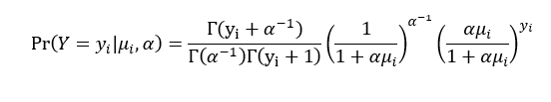
Negative Binomial Regression
When the mean of the count is lesser than the variance of the count, then Negative binomial regression is used to test for connections between confounding and predictor variables on a count outcome variable. Negative binomial regression is most commonly used to model over-dispersed count outcome variables.
In negative Binomial Regression, the dependent variable mean is calculated using the time t and k independent variables.
The fundamental negative binomial regression model for an observation i is

Slide 9

Logistic Regression
By examining the correlation between one or more current independent variables, a logistic regression model forecasts a dependent variable in the data.
Using logistic regression we can classify the dependent variable into categories.
In this study we have taken the outbreak happened as dependent variable and no of cases, no of deaths, annual rainfall and area of the state as independent variables.

Slide 10
Analysis and Results
Hotspot Analysis
Year | 2020 | 2021 | 2022
Most Likely Cluster (cases) | Kannur | Firozabad | Fatehgarh Sahib
Most likely cluster (deaths) | Kannur | Bellary | Bangalore Rural, Chikkaballapur , Krishnagiri, Mysuru

Slide 11

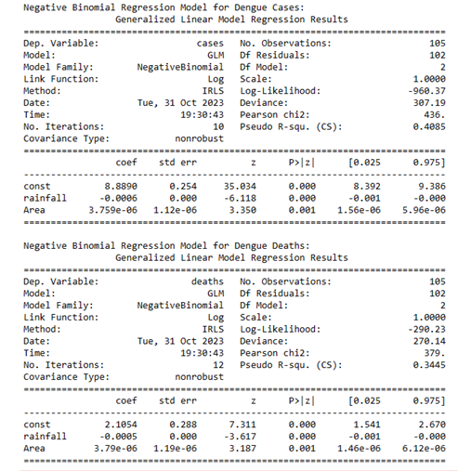
2. Negative Binomial Regression
A negative Binomial Regression model has been developed for both the dengue cases and deaths prediction using the data of three years 2020,21,22.
The following are the resulting models obtained with coefficients and various parameters like deviance etc.
Using these models we can predict the number of dengue incidences based on the factors like rainfall, area etc.

Slide 12
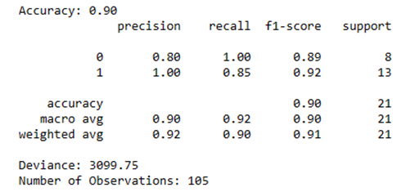

3. Logistic Regression
A logistic model has been developed to classify the states based on the outbreak status and this outbreak severity is based on the various factors like no of cases,rainfall etc
The threshold for the variable y outbreak has been taken based on the proportion of the number of dengue cases with the annual rainfall. If the proportion is greater than 0.5 then it is classified as outbreak(1) otherwise 0.

Slide 13
Conclusion
According to hotspot analysis, the districts in Karnataka like Bellary, Bengaluru Rural, Chikkaballapur, Krishnagiri, and Mysuru have emerged as the primary regions for dengue-related deaths in the years 2021 and 2022. These findings indicate the inadequate treatment provided to patients suffering from dengue in these areas.
Using Negative binomial regression two predictive models for cases and deaths respectively have been developed which can be used to predict the cases and deaths.
It is obtained that both the models are well developed since the ratio of the deviance with the degrees of freedom which is the difference between the total number of observations and number of parameters i.e.105-5=100 of both the models is greater than 1.
The developed model has been giving an accuracy of 90% and the training and testing data has been taken in the ratio 80:20.

Slide 14
References
Improving Dengue Forecasts by Using Geospatial Big DataAnalysis in Google Earth Engine and the Historical Dengue Information-Aided Long Short Term Memory Modeling, Zhichao Li 1, Helen Gurgel 2 , Lei Xu 3 , Linsheng Yang 1 and Jinwei Dong 1,*
Potential effect of population and climate changes on global distribution of dengue fever; an empirical model, Simon Hales, Neil de Wet, John Maindonald, Alistair Woodward.
Statistical Modelling of the effect of rainfall flushing on dengue transmission in Singapore , Corey M. BenedumID Osama M. E. Seidahmed Elfatih A. B. Eltahir3 Natasha Markuzon1*
Increasing Dengue Incidence in Singapore over the Past 40 Years: Population Growth, Climate and Mobility, Claudio Jose Struchiner, Joacim Rocklöv, Annelies Wilder-SmithEduardo Massad.
A data-driven epidemiological prediction method for dengue outbreaks using local and remote sensing data, Anna L Buczak*, Phillip T Koshute, Steven M Babin, Brian H Feighner and Sheryl H Lewis.
The current and future global distribution and population at risk of dengue, Jane P. Messina 1,2,17*, Oliver J. Brady3,4,17, Nick Golding 5, Moritz U. G. Kraemer 6,7,8, G. R. William Wint9, Sarah E. Ray10, David M. Pigott10, Freya M.Shearer11, Kimberly Johnson10, Lucas Earl10, Laurie B. Marczak10, Shreya Shirude10, Nicole Davis Weaver 10, Marius Gilbert12, Raman Velayudhan13, Peter Jones14, Thomas Jaenisch15, Thomas W. Scott16, Robert C. Reiner Jr10,18 and Simon I. Hay
Knowledge, attitude and practice on dengue prevention and dengue seroprevalence in a dengue hotspot in Malaysia: A cross-sectional study, Sivaneswari Selvarajoo 1, Jonathan Wee Kent Liew 1, Wing Tan1, Xin Ying Lim1, Wardha F . Refai2, Rafdzah Ahmad Zaki3, Neha Sethi4, Wan Yusoff Wan Sulaiman1, Yvonne Ai Lian Lim1, Jamuna Vadivelu5 & Indra Vythilingam1
The current and future global distribution and population at risk of dengue, Jane P. Messina 1,2,17*, Oliver J. Brady3,4,17, Nick Golding 5, Moritz U. G. Kraemer 6,7,8, G. R. William Wint9, Sarah E. Ray10, David M. Pigott10, Freya M.Shearer11, Kimberly Johnson10, Lucas Earl10, Laurie B. Marczak10, Shreya Shirude10, Nicole Davis Weaver 10, Marius Gilbert12, Raman Velayudhan13, Peter Jones14, Thomas Jaenisch15, Thomas W. Scott16, Robert C. Reiner Jr10,18 and Simon I. Hay

Slide 15
Thank you

